Slide 1
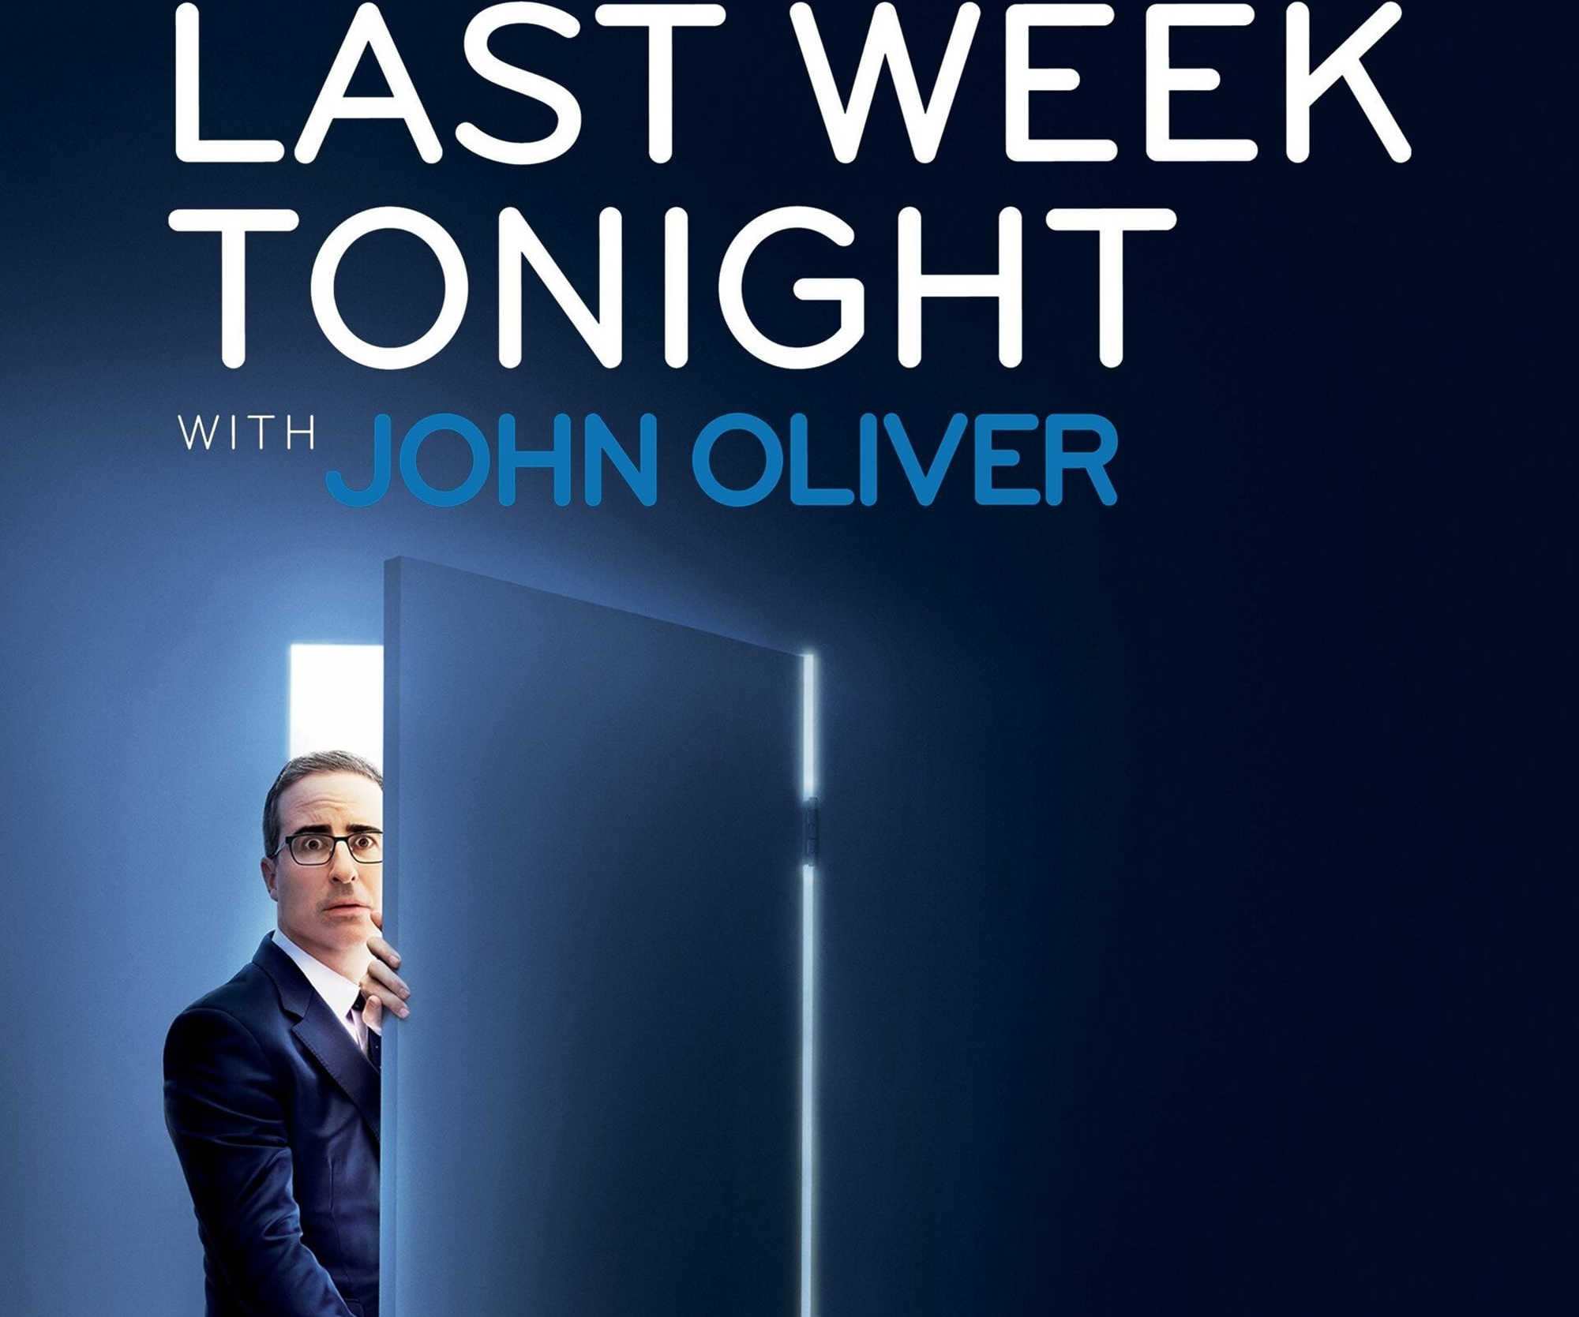
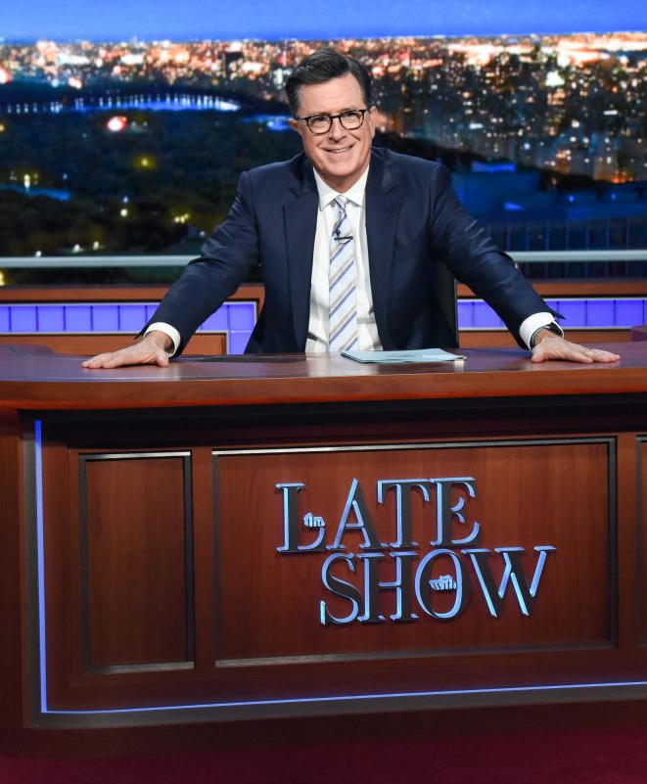
Research Methods Article Review and Critique
Department of Communication Studies
Lindsay J. Osborn
CMCL-C424: Communication Research Methods
Dr. Rosalie S. Aldrich
December 4, 2022

Slide 2
Presentation Preview
Study Overview
Variables & Hypotheses
Framework
Method
Results
Strengths and Weaknesses

Slide 3
Article information
Title: Comedic cognition: The impact of elaboration on political comedy effects
Authors: Freddie J. Jennings, Josh C. Bramlett, & Benjamin R. Warner
Journal: Western Journal of Communication, Vol. 83, 2019.

Slide 4
Variables & Hypotheses
Affinity for Political Humor (Hmielowski et al., 2011)
Elaboration (Reynolds, 1997)
Information Acquisition
Attitude Congruence
H1: Higher elaboration on messages in long-form political comedy will be associated with greater a) information acquisition (both recognition and recall) and b) attitude/message congruence.
H2: Affinity for political humor will be positively associated with a) information acquisition and b) attitude/message congruence.

Slide 5
Reversal Theory (Apter, 2001) & Hypotheses
Telic
Paratelic
Control Group
H3: Telic (serious) framing will increase message elaboration.
H4: Paratelic framing will decrease message elaboration among those low in affinity for political humor.

Slide 6
Study Overview: Sampling
Randomized study
179 Midwestern Communication/Journalism students
Average age 19.8
102 females 77 males
Predominantly white
39.1% (n = 70) Democrat
40.6% (n = 73) Republican

Slide 7
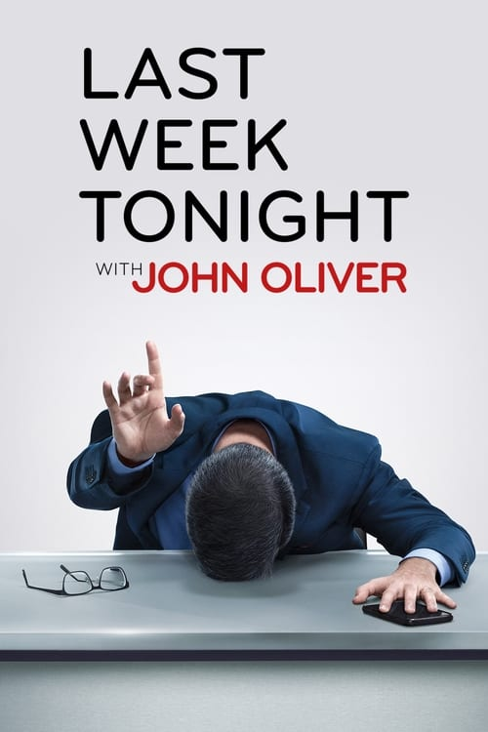
Methods Overview: Testing
Pretest
Affinity for political humor/demographics (Hmielowski et al., 2011)
11-item scale
Recorded on a 7-point Likert-type scale
(1 = strongly disagree; 7 = strongly agree)
Randomly-assigned framing
Telic: “Check out this informative video from John Oliver’s show…”
Paratelic: “Check out this hilarious video from John Oliver’s show…”
Neutral: “Check out this video from John Oliver’s show…”
Stimulus
Program: Last Week Tonight
Time: 13:11 minutes
Subject: Rights of the five U.S. territories
Post-test
Elaboration
12-item statements; 7-point Likert-type scale
Information Acquisition
Separate recall & recognition test; four fill-in-the-blank items, six possible answers
Attitude Congruence
6-item statements; 7-point Likert-type scale

Slide 8
Results
Analyzed using Cronbach’s alpha using Maximum Likelihood (ML) model in program Lavaan (Jennings et al., 2019)
Affinity for Political Humor (α = .92)
Elaboration (α = .91)
Information Acquisition (analyzed separately – no α)
Attitude Congruence (α = .78)
Hypotheses
Consistent with H1
Inconsistent with H2
Contrary to H3
Consistent with H4

Slide 9
Strengths
Randomized experiment
Reliable scales
Adequately utilized R analysis & Cronbach’s alpha (.70 or higher)
Hypotheses based on existing research/theories

Slide 10
Weaknesses
Authors’ Acknowledgements (Jennings et al., 2019)
Personal Observations
Weak/unnatural priming statement
Did not observe/assess mindset of participants
Video not naturally shared
Convenience sample
Low-salience topic
No IRB approval/informed consent
Convenience sample – conflicts of interest?
Randomized…but how?
Condensed long-form segment
Pretest

Slide 11
Conclusions
Is political comedy worth studying?
How can future studies improve research?

Slide 12
References
Apter, M. J. (2001). An introduction to reversal theory. In M. J. Apter (Ed.), Motivational styles in everyday life: A guide to reversal theory (pp. 3–36). Washington, DC: American Psychological Association.
Hmielowski, J. D., Holbert, R. L., & Lee, J. (2011). Predicting the consumption of political TV satire: Affinity for political humor, The Daily Show, and The Colbert Report. Communication Monographs, 78(1), 96–114. doi:10.1080/03637751.2010.542579
Reynolds, R. A. (1997). A validation test of a message elaboration measure. Communication Research Reports, 14(3), 269–278. doi:10.1080/08824099709388670
Jennings, F. J., Bramlett, J. C., & Warner, B. R. (2019). Comedic cognition: The impact of elaboration on political comedy effects. Western Journal of Communication, 83(3), 365–382. https://doi-org.proxyeast.uits.iu.edu/10.1080/10570314.2018.1541476

