Slide 1
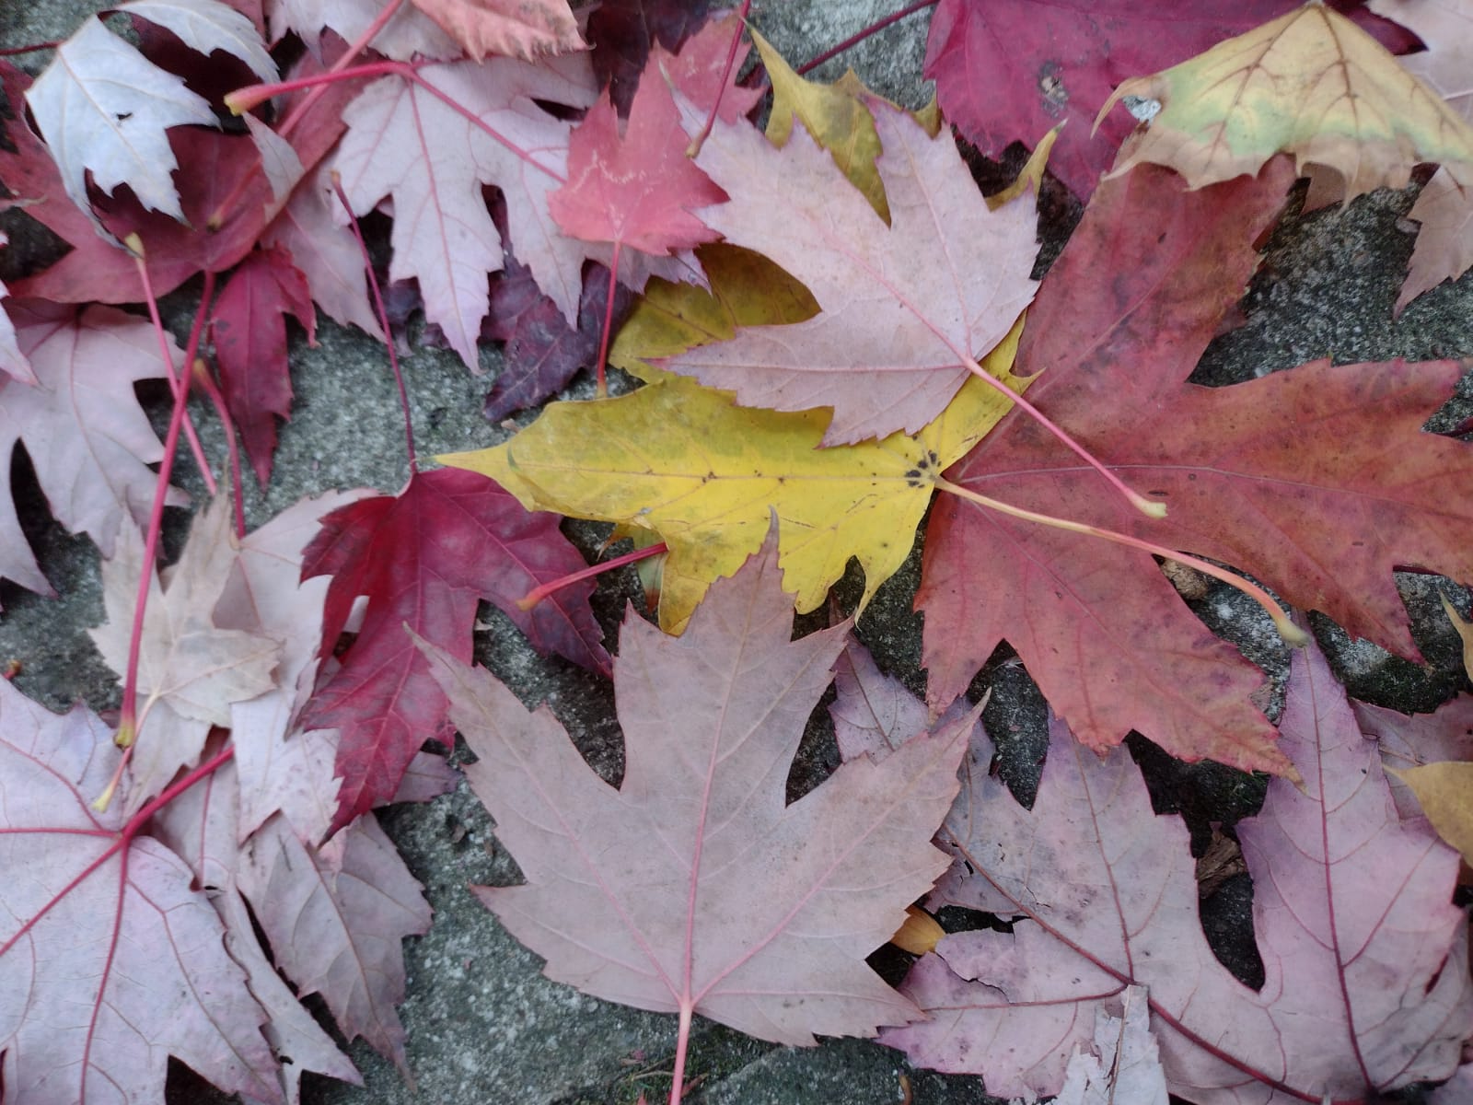
Class Activity: Photovoice and our daily lives
Engaging in social research methods

Slide 2
Photovoice Class Activity
To understand what social research methods are and the transformative and powerful effect and intent of these methods, it is useful to participate in them an know what you are asking of participants.
Photovoice is a research method that centers personal agencies and subjectivities in a participatory arts-based workshop. In photovoice, participants are gathered to take photos of their daily lives and accompany these photos with written reflections. After taking their photos and writing their narratives, participants come together in a group discussion to talk about what their photovoice means to them and identify collective themes emerging across the arts pieces (Amos et al., 2012; Jarldorn, 2019).

Slide 3
Photovoice Class Activity
Activity Instructions:
Each person will have a chance to walk around our building, and reflect on the following questions:
Question 1.
Question 2.
Question 3.
Take photos and write a very brief description on their photo, from 2-3 sentences to 1 paragraph in length (no more than 250 words).
Post 1-2 photos and descriptions on to the following Google Doc (include your name):
Alternatively, you may send your photo to me via email: email here.
We will then come together collectively to flip through these submissions and talk about them collectively in a group discussion.
Please take about 15-20 minutes on the photography and narrative parts, and we can take between 15-20 minutes on the group discussion.

Slide 4
Photovoice Class Activity
SHOWeD reflection questions:
What do you see?
What is really happening here?
How does this relate to our lives?
Why do these conditions exist?
What can we do about it?
Final reflection questions:
Why did we do this exercise?
What is its utility, and its limitations, in research?
What purpose can this method serve in social geographic research on climate change?

Slide 5
