Slide 1
Quick Check
E-Learning Tools Session: Interactive Assessments Unleashed
INDIANA UNIVERSITY COLUMBUS

Slide 2
Why are low-stakes formatives important?
Purpose and Relevance

Slide 3
Here are some reasons
Promote active learning
Reduce test anxiety
Provide timely feedback
Identify misconceptions early

Slide 4
Learning Objectives
Set up Quick Check on a Canvas course
Configure a Quick Check set
Understand different question types
Create a Quick Check

Slide 5
Let’s move this to Canvas
The Practical Part

Slide 6
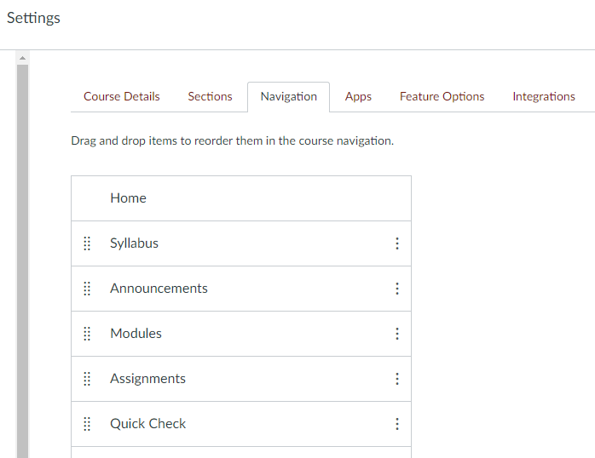
Enabling Quick Check
You can enable Quick Check in the course settings.
The option will be under the “Navigation” tab.

Slide 7
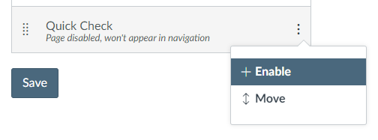
Enabling Quick Check
If you’ve never done this before, first scroll down to find the Quick Check option.
Then use the three dots on the right side to “Enable” the LTI.
Remember to hit “Save”, or it won’t appear on your left sidebar menu.

Slide 8
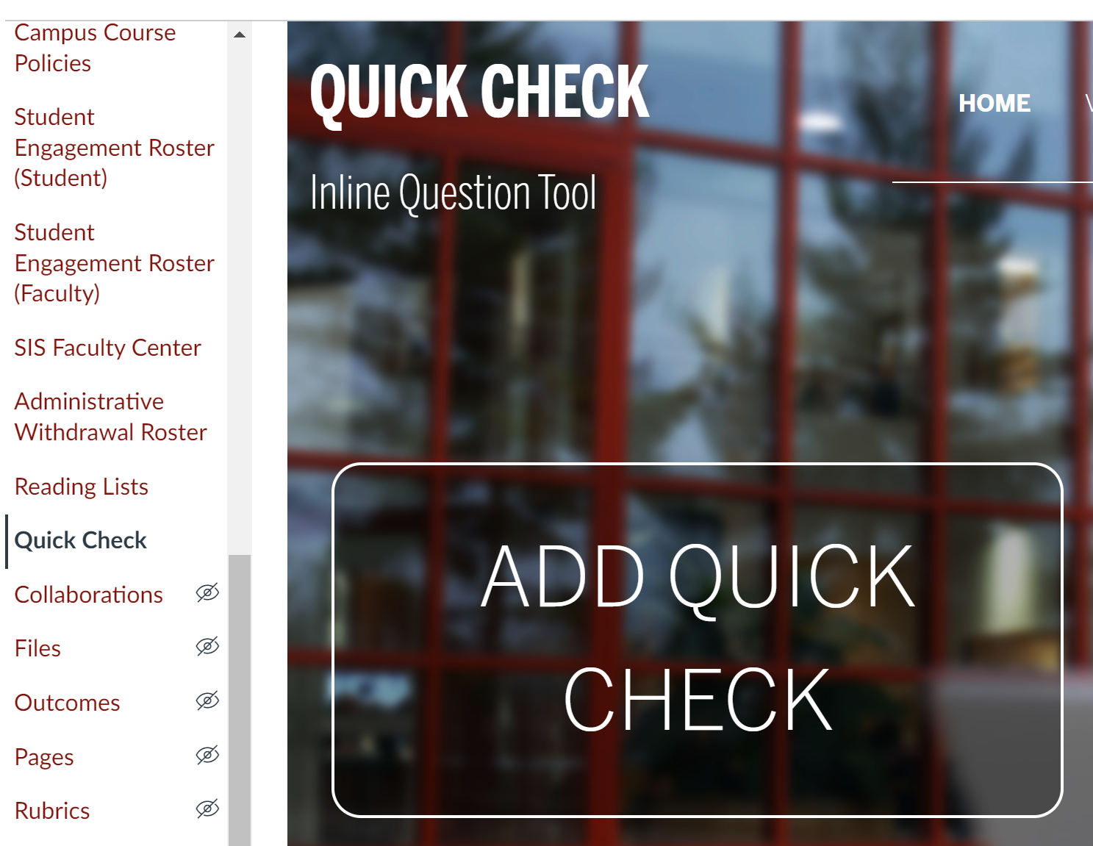
Creating a set in Quick Check
Look for Quick Check on your left sidebar menu.
Click on the giant “ADD QUICK CHECK” to get started.

Slide 9
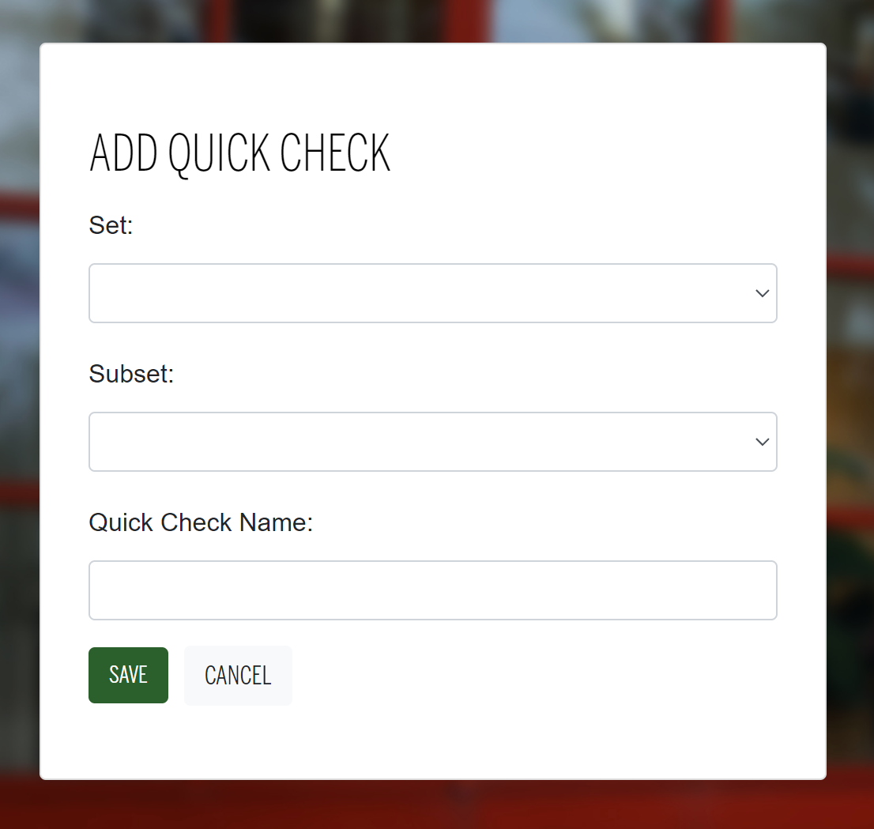
Creating a set in Quick Check
Create a set name, which is usually a course or module-related title.
Create a subset name, which is a section or chapter-related title.
Create a Quick Check name, which is usually the activity title.

Slide 10
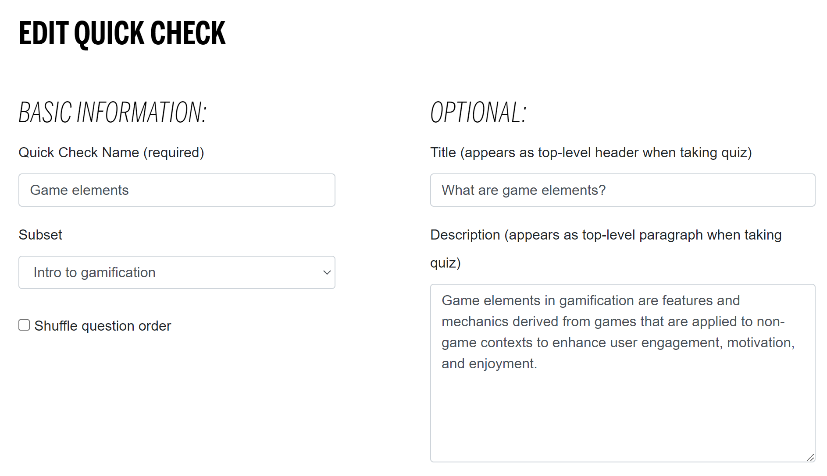
Creating a Quick Check
Fill out the fields for the Quick Check name and make sure it’s in the correct subset.
You can also add more information that will be visible to learners in the optional section.

Slide 11
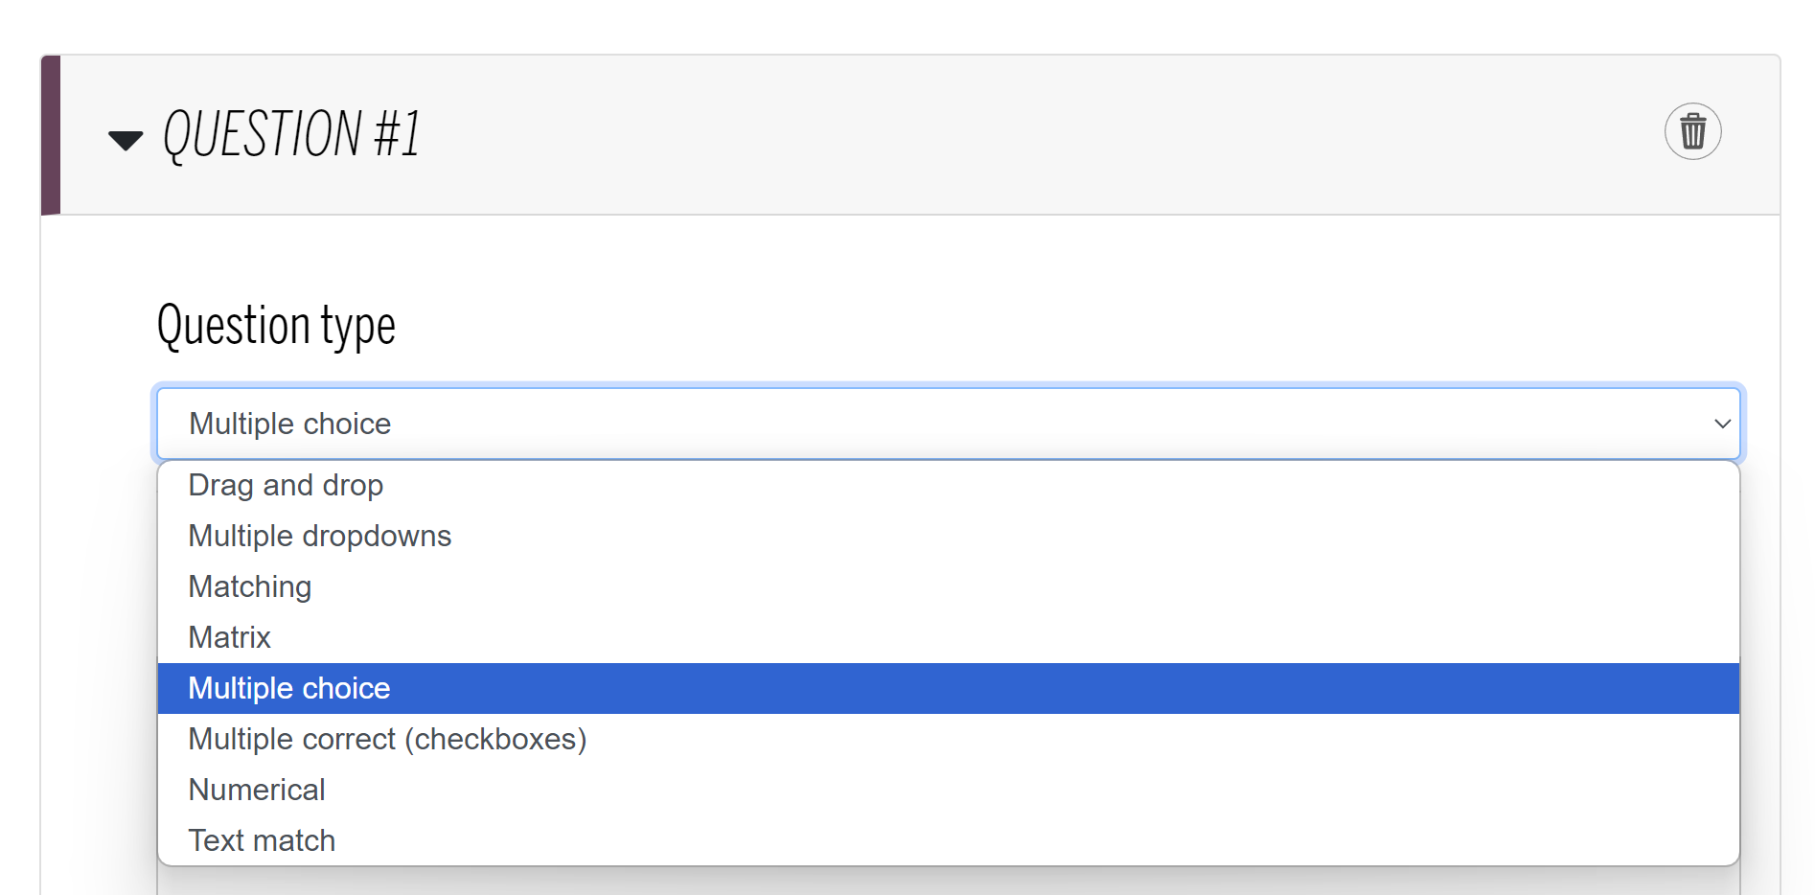
Creating a Quick Check
Ensure you pick the question type that you want before you start editing the question text.
Quick Check allows you to create questions with an equation editor except for dropdown answers.
Once you’re happy with your questions, click the “SAVE QUICK CHECK” button at the bottom.

Slide 12
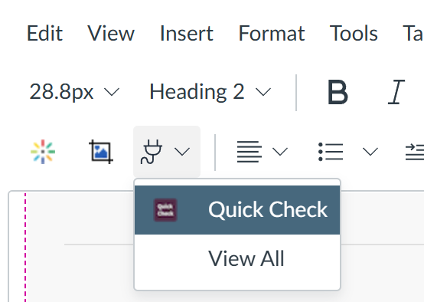
Embedding your ungraded Quick Check
Open the desired page in Edit view and move the cursor to the desired place for the Quick Check.
Click on the App button (looks like a plug). If you don’t see it, click the three dots on the right side of the text editor menu.
Select Quick Check (or View All and the look for Quick Check).

Slide 13
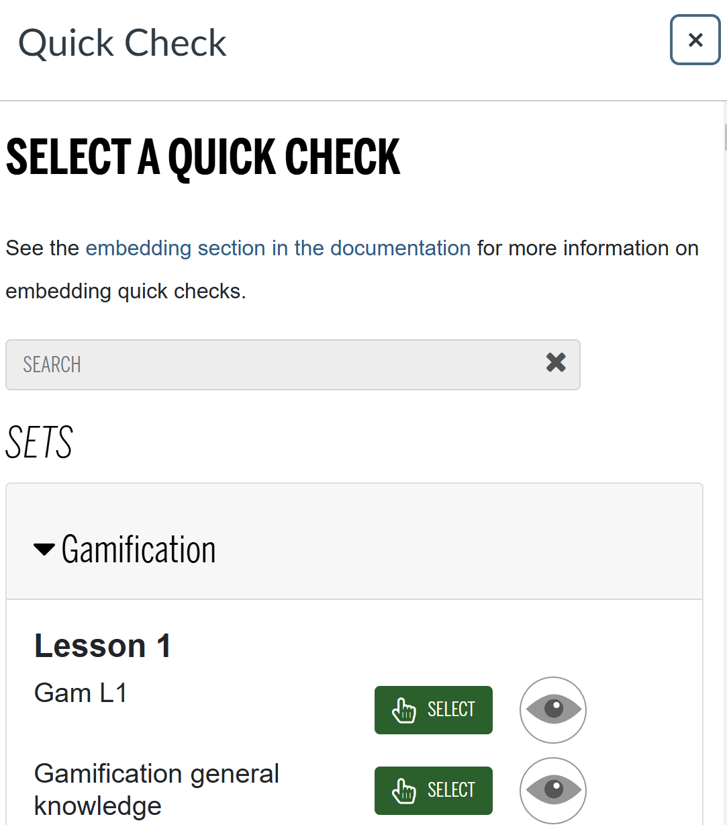
Final Step
Finally, look for the relevant Quick Check and click “SELECT”.
You can also preview Quick Checks with the eye symbol.
Now your Quick Check is ready to go! You can view analytics and make changes in the Quick Check tool on the left sidebar menu.

Slide 14
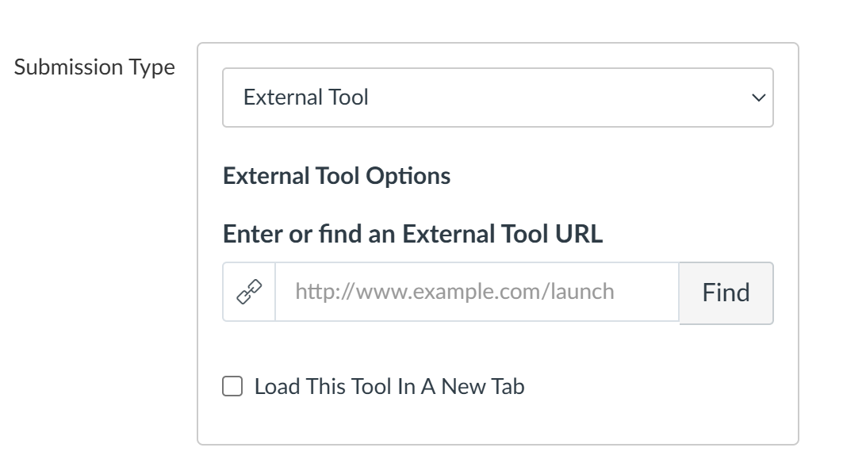
Embedding your graded Quick Check
Open desired assignment in Edit view and go to “Submission Type”.
Select “External Tool” from the drop-down menu.
Click on “Find” and look for Quick Check.

Slide 15
Final Step
Finally, look for the relevant Quick Check and click “SELECT”.
You can also preview Quick Checks with the eye symbol.
Now your Quick Check is ready to go! You can view analytics and make changes in the Quick Check tool on the left sidebar menu.

Slide 16
If you have any questions, please reach out!
tgovende@iu.edu

