Slide 1
STUDENT SUCCESS SERIES: FIRST GENERATION COLLEGE STUDENTS
Austin Newberry/Joan Poulsen,
IU Columbus
O. Bennett, Ivy Tech Columbus

Slide 2
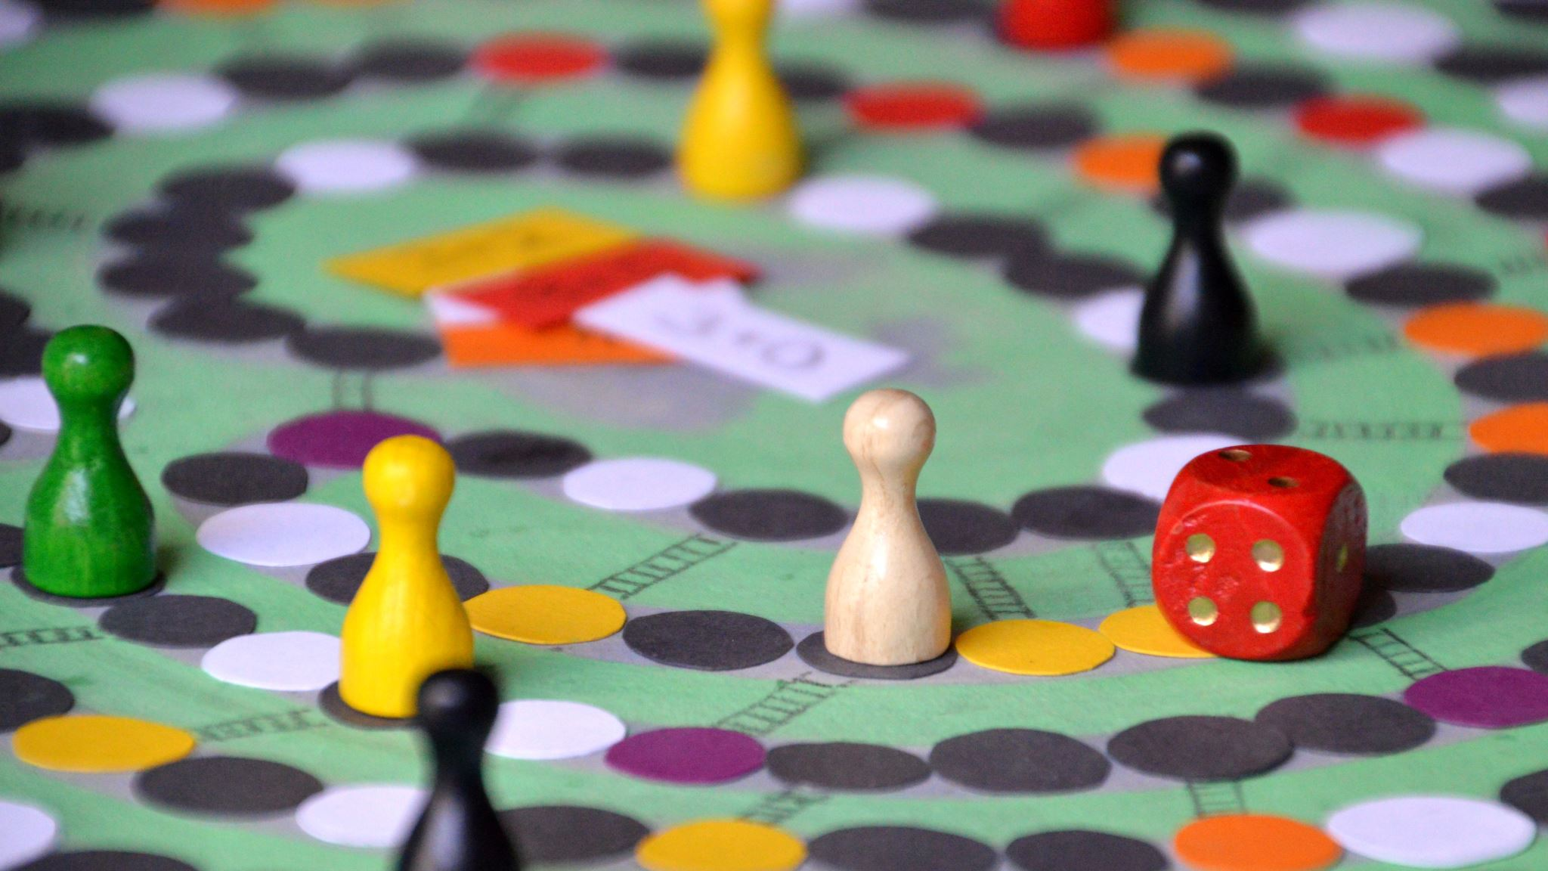
I WANT TO PLAY A GAME…
The Writing Challenge

Slide 3
HOW DID YOU KNOW…
Austin/Jane
O

Slide 4
WHAT IS FIRST GEN?
1st in their family to attend college or parents did not complete college
May include Non-traditional students: Home schooled or received education from different country
Campus demographics: Approx: 30% at IU Columbus and 22% at Ivy Tech Columbus
Fist Gen students may not know that they are first gen.

Slide 5
BRINGING 1ST GEN STUDENTS TO THE TABLE

Slide 6
VOICES OF THE STUDENTS
Name, major, institution
How was your educational experience before college?
What made you choose to go to college?
How has being one of the first people in your family to go to college affected your life/How has your life changed since attending college?
Knowing what you know now, what advice would you give to your younger self?
How can faculty better support you?

Slide 7
WHAT CAN YOU DO?
Have an asset focused approach
Recognize, appreciate and affirm differences that exist in the campus community
Assess the needs throughout the full student life cycle
Increase visibility and outreach
Equip and empower student to master the hidden curriculum
Leverage alumni groups
Other ideas?

Slide 8
QUESTIONS

