Slide 1
Pig Kidney Dissection
Virtual Laboratory

Slide 2
Kidney Dissection Video
Watch the following kidney dissection from YouTube:
Pig Kidney Dissection and Urine Formation
The kidney anatomy shown in the video is very good. Note all the major structures: renal medulla, renal cortex, renal pyramids, renal columns, major and minor calyces and the renal pelvis
View the following slides of the labeled pig kidney. Learn the labels for your lab exam. I will be using these pictures on your virtual lab exam.

Slide 3
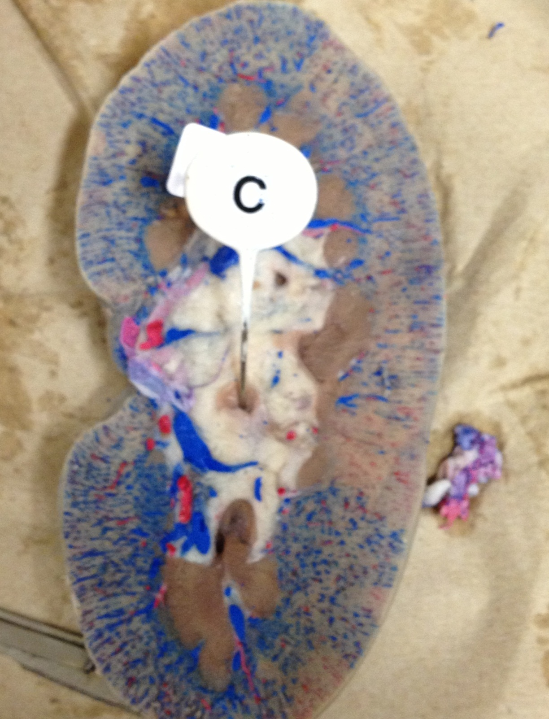
Renal Capsule- Outer layer
Renal
Cortexouter layer
Renal
Medulla Inner layer
Hilum

Slide 4
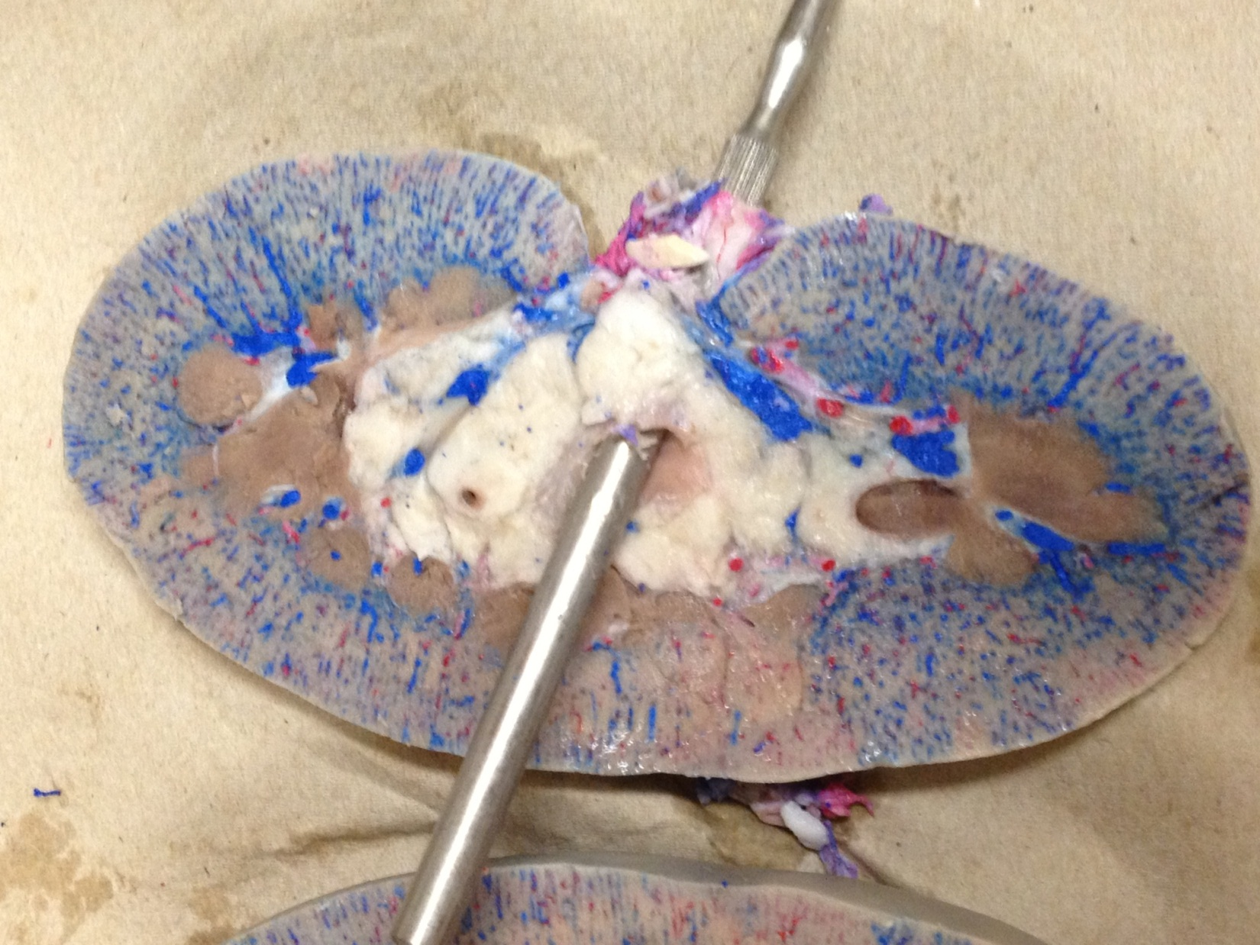
The probe is
through the
ureter
The probe is
entering the
Renal Pelvis
Renal Medulla
Inner Layer

Slide 5
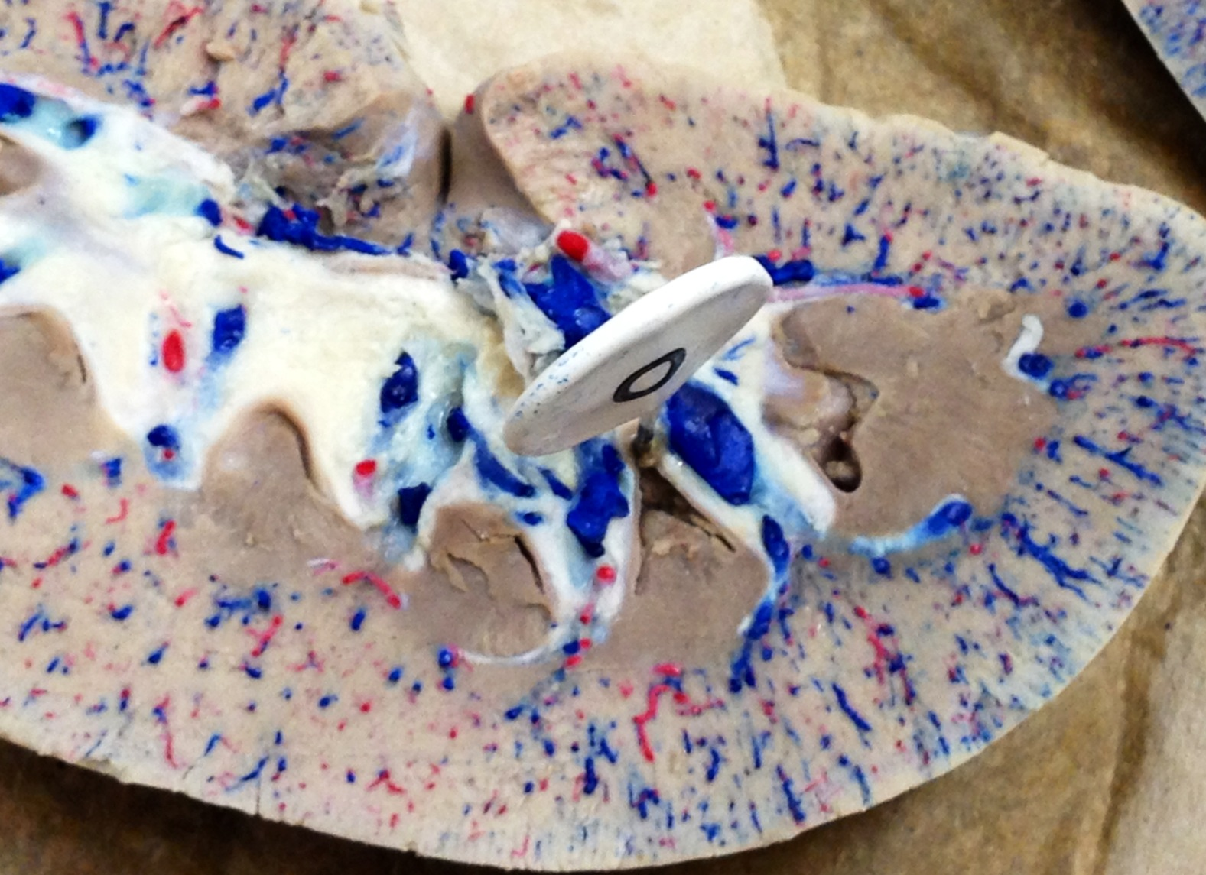
Major Calyx- usually 2-3 per kidney. Minor calyces drain fluid into the major calyces
Minor
Calyx
8-15 per kidney
Renal papilla of
Renal pyramid

Slide 6
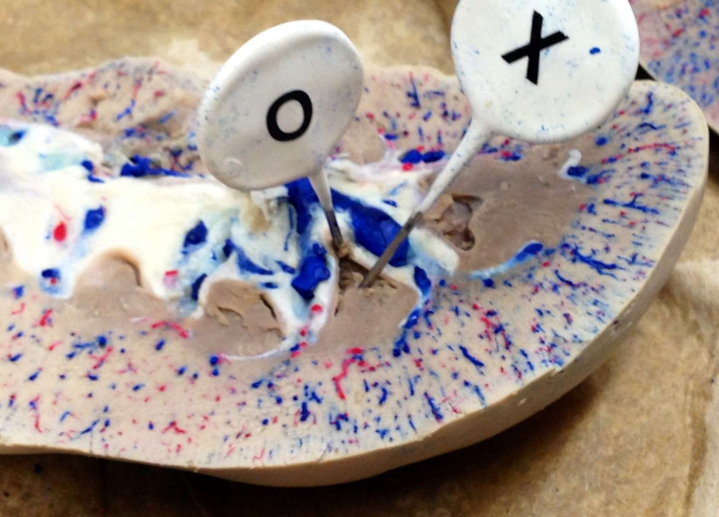
“O” = Minor
Calyx
“X” = Renal
Papilla
Renal cortex
Renal pyramid

Slide 7
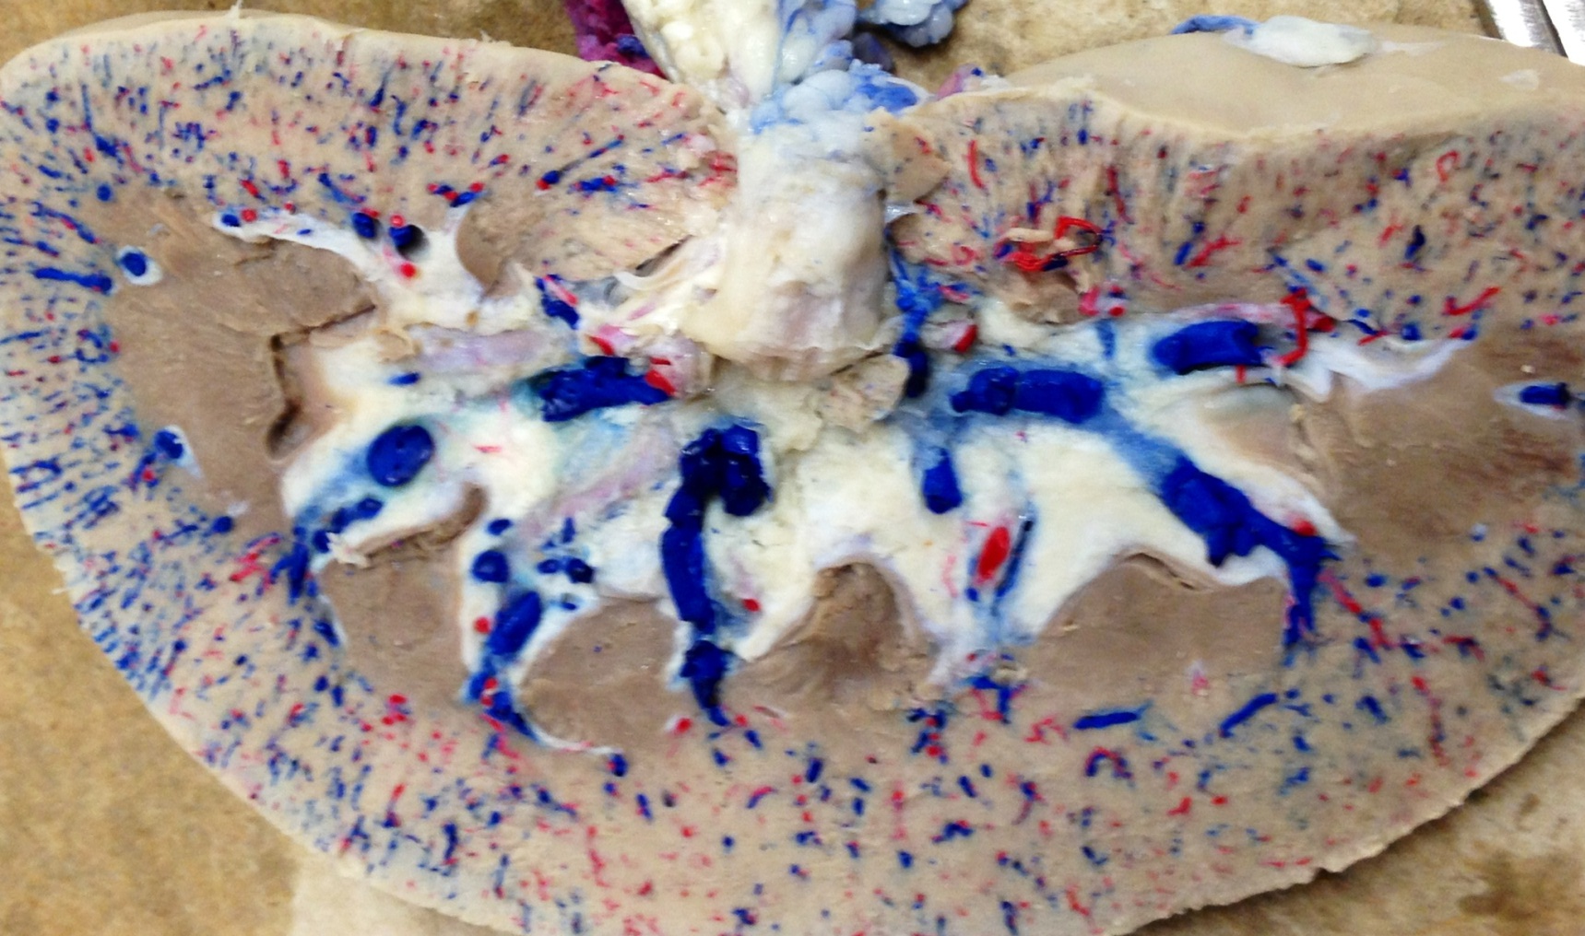
Renal Pelvis is the area inside
the tetrahedron (see video for a better view)
Major Calyx
Major Calyx
Renal Columns-
extensions of the renal cortex
that subdivide the renal medulla into renal pyramids
Renal papilla of
renal pyramid
Renal pyramid
In the renal medulla

